Slide 1

Food Recognition And Calorie Estimation Using Image Processing
JAHID HASAN 1721208042
ISMAIL BIN SUHRWARDY 1812628042
MD. SABBIR HOSSAIN
1821101042

Slide 2
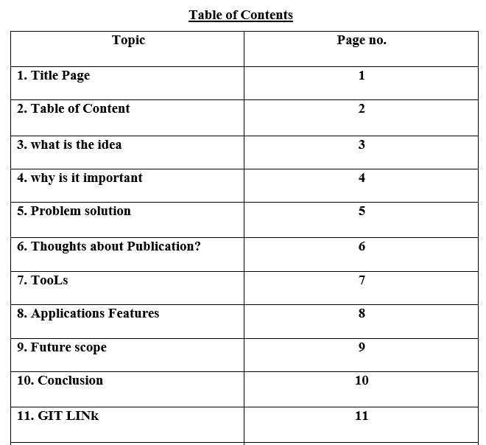
Road Map

Slide 3

What is the idea?
The main idea of our project is to create a web based system which will be powered by deep learning that will allow our users to know the calorie of a certain food item just by uploading a picture of it.

Slide 4

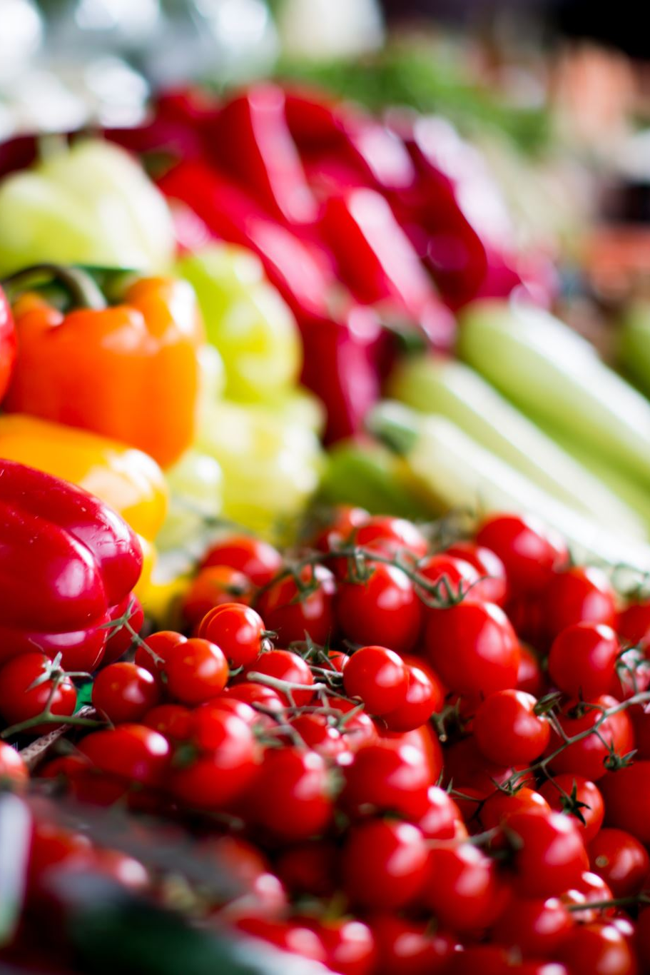
Why is it important?
This will help those who are highly health conscious. Our users will be able to know the calorie of a food just by uploading an image. Every time while eating if they want to know that how much calorie they are consuming this will beneficial for them.

Slide 5
How do you want to solve it?
Solution
We have to manually create a dataset by collecting different types of food item images and their corresponding calories. We will collect 50-60 types of food images, although it can vary later depending upon availability. Then we will create a robust and reliable deep learning model that will help us to detect certain food images. After that we will build a web application using that model to show calorie of a food item uploaded by the user.

Slide 6

Are you going for a publication? Why?
Currently we don’t have any intention of publishing our work.

Slide 7

What tools do you want to use
Language- Python
DL framework- Tensorflow
Web framework-Django
Frontend – CSS,HTML

Slide 8
Application Functions:
Main function is :
Food Recognition
And
Calorie Estimation Using Image Processing

Slide 9
Future Implementation Scope:
We will try to include more features. For example,
● The web application can be converted into mobile app for more user convenience
● More categories of food can be trained in future
● Multiple layers in single food item can be recognized
● Calorie can be estimated with the help of volume
● Better User Interface (UI)

Slide 10
Our final and end goal is to create a nice web application for the user that will be easy to use and backed by a fine-tuned deep learning model. We can expect it will surely help our society to maintain a healthy diet
Conclusions

Slide 11
Github Link :
https://github.com/Ismail-Bin-suhrwardy/CSE499_Senior_Design.git

Slide 12
Thank You

